Slide 1
Student portfolio

Slide 2
Student information
About me
Academic information
Skills
Portfolio website
Achievement
Extracurricular activities
Personal details

Slide 3
Student information:
name : A. Keerthika
Course : Bsc computer science 2nd year
College name : valliammai women’s College of arts and science
Email ID : keerthikasekar2006@gmail.com
Phone no : 9345329848

Slide 4
About me :
I am a 2nd year batchelor of computer science student with a passion for software development problem solving and data analysis my academic journey has helped me develop strong technical and analytical skills.

Slide 5
Academic information
Degree/course:b.sc computer science
Institution : valliammai women’s College of arts and science
Year: 2024-2025
Grade: 75%

Slide 6
Skills
Technical skills : python,DSA, html,c++,css, Java script,Java.
Software skills : communication, teamwork, problem solving, leadership.

Slide 7
Portfolio website
Create a personal webset using html,css and Java script.

Slide 8
Achievement :
Tennis player in our inter College tornament secured 1st place in coding. Won best paper presentation on artificial intelligence.

Slide 9
Extracurricular activities:
Habbies and intrest:
Tennis player and story reader also members of the computer science club active participent in inter College cultural events.

Slide 10
Personal details:
Date of birth:21.11.2006
Language: Tamil, English.
Intrest: tennis player, story reader and cooking.

Slide 11
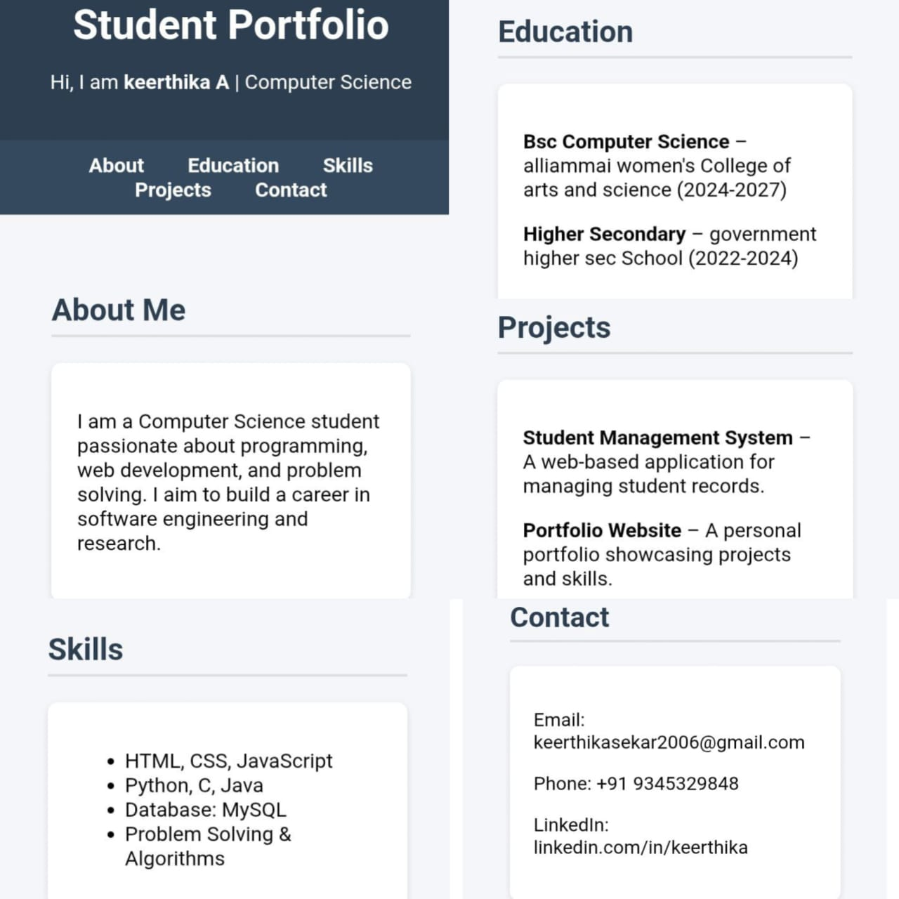

Slide 12
End:
Thank you

